Slide 1
Where should I move to in California?
Abhinav Bais
6/19/2020

Slide 2
Introduction
A friend of mine currently residing in Florida wants to relocate to California to have a better life but is confused which city to choose. He would like to stay in a place where there is great weather, fantastic food, top notch education, plenty of adventures and a thrilling night life along with a safe environment. He has shortlisted a couple of cities and would like to select one of them. The shortlisted cities are San Francisco, Los Angeles, San Jose and San Diego. Our goal is to explore these cities and recommend the best city.

Slide 3
Data
Foursquare Location – This will be used to explore the social life in each of the 4 cities
US Climate – This will be used to analyze the year round weather
California open data portal – This will be used to analyze the crime rates.

Slide 4
Insights
Social Life
San Francisco – This is a very good city for people who are interested in performing arts and music. There are concert halls, dance studios, theatres, rock/jazz clubs. The city also has quite a good options for eating and drinking. There are Japanese, French, Vietnamese and Scandinavian restaurants along with wine, beer and cocktail bars.
Los Angeles - This is a very good city for people who are interested in performing arts and historical places. There are museums, historic sites, art galleries, concert halls, theatres and jazz clubs.

Slide 5
San Diego – The city has a wide variety of options for eating. There are Japanese, French, American, Mexican, Mediterranean and Brazilian restaurants.
San Jose - The city has a variety of options for eating and drinking. There are Japanese, Caribbean, Korean, Mexican and Asian restaurants along with pubs, beer and cocktail bars.
Climate
San Jose has more extreme temperatures as compared to the other cities. Moderately hot summers and cold winters.
San Francisco remains cool(comfortable) throughout the year
San Diego and Los Angeles have similar weather having pleasant climate throughout the year.

Slide 6
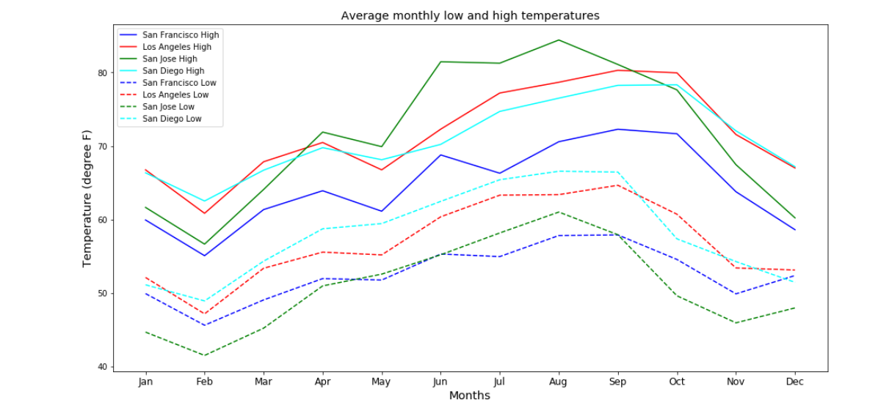

Slide 7
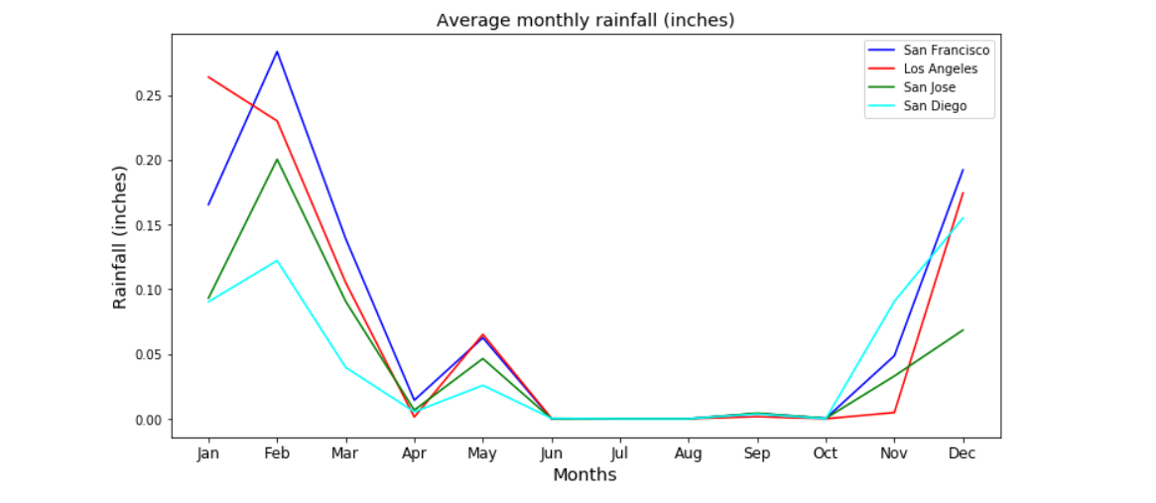
All 4 cities receive nearly similar rainfall throughout the year.

Slide 8
Safety
Los Angeles has seen a steep drop in violent crime rates over the years.
San Jose and San Diego have a similar drop in crime rate but not as much as San Francisco.
Crime rate in San Francisco seems to go up and down being much worse than the other 3 cities.

Slide 9
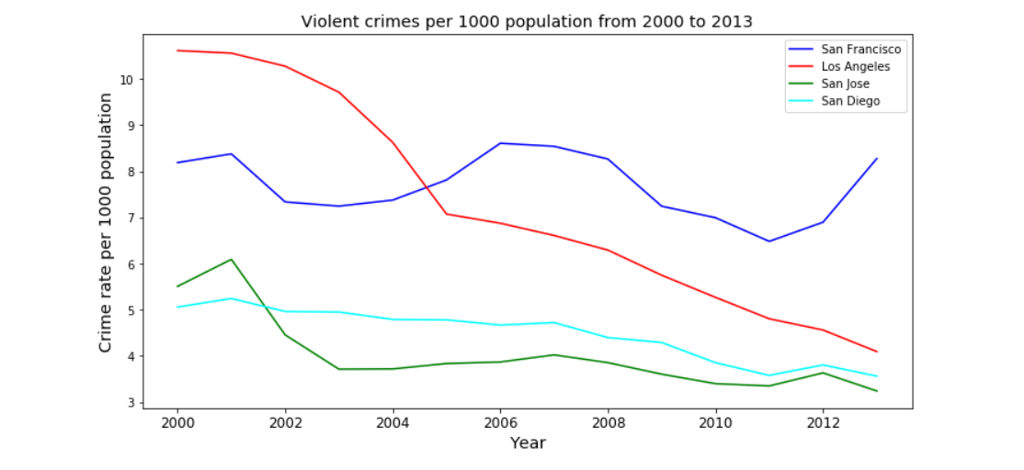

Slide 10
Results
As far as food and night life is concerned San Jose seems to have a good mix of both. San Diego is good for trying out different cuisines. Los Angeles is into performing arts and historical places. San Francisco has a good mix of arts, cuisines and night life.
Climate wise San Francisco is the best followed by Los Angeles and San Diego.
As far as safety is concerned San Jose tops the list with San Francisco being the worst.

Slide 11
Recommendation
After considering all the factors I would recommend San Jose or San Diego as the cities to move to since they fared well in all aspects. When it came to social life all cities had something good and unique about them. Weather was also not much of a big differentiator. Safety played a big role in reaching to a conclusion since it is one of the most important aspects and made San Jose and San Diego stand apart.

Slide 12
Conclusion
We can also consider other factors like IT job opportunities and housing costs in each city to make a better decision. Currently there was no data available to perform analysis but should be considered doing so in future.

Slide 13

Thank You

